Slide 1

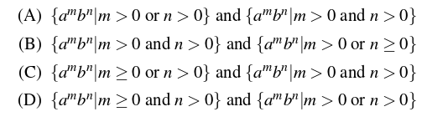
GATE Exam Question
Consider the following context-free grammars:
Which one of the following pairs of languages is generated by G1 and G2, respectively
Answer: (D) Explanation: In G1, there will be atleast 1 b becase S->B and B->b. But no. of A’s can be 0 as well and no. of A and B are independent.
In G2, either we can take S->aA or S->bB. So it must have atleast 1 a or 1 b.
So option D is correct.

Slide 2
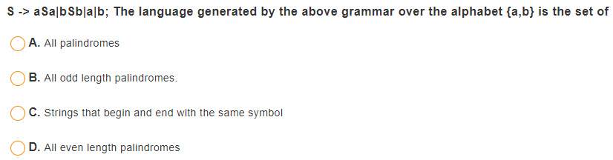
Question

Slide 3
Question
The context free grammar S → SS | 0S1 | 1S0 | ɛ generates
a. Equal number of 0’s and 1’s
b. Unequal number of 0’s and 1’s
c. Number of 0’s followed by any number of 1’s
d. None of the mentioned

Slide 4
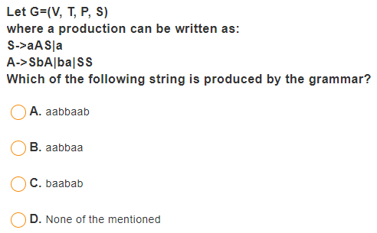
Question

Slide 5
Question
Grammar that produce more than one Parse tree for same sentence is:
a. Ambiguous
b. Unambiguous
c. Complementation
d. Concatenation Intersection

Slide 6
GATE Exam Question
Consider the following statements about the context free grammar G = {S -> SS, S -> ab, S -> ba, S -> ε } I. G is ambiguous II. G produces all strings with equal number of a’s and b’s
Which combination below expresses all the true statements about G? A. I only B. I and II only
Solution : There are different Left Most Derivation’s for string abab which can be S => SS => SSS => abSS => ababS => abab S => SS => abS => abab So the grammar is ambiguous. So statement I is true. Statement II states that the grammar G produces all strings with equal number of a’s and b’s but it can’t generate aabb string. So statement II is incorrect.

Slide 7
Answer
What is the maximum number of reduce moves that can be taken by a derivation process for a grammar with no epsilon- and unit-production (i.e., of type A -> є and A -> a) to derive a string with n tokens ? (A) n/2 (B) n-1 (C) 2n-1 (D) 2^{n}
Answer: (B)

Slide 8
Answer
Answer: (B) (n-1) Explanation: Given in the question, a grammar with no epsilon- and unit-production (i.e., of type A -> є and A -> a).
To get maximum number of Reduce moves, we should make sure than in each sentential form only one terminal is reduced. Since there is no unit production, so last 2 tokens will take only 1 move.
So To Reduce input string of n tokens, first Reduce n-2 tokens using n-2 reduce moves and then Reduce last 2 tokens using production which has . So total of n-2+1 = n-1 Reduce moves.

Slide 9
Answer (Contd…)
Suppose the string is abcd. ( n = 4 ).
We can write the grammar which accepts this string as follows:
S->aB B->bC C->cd
The Right Most Derivation for the above is:
S -> aB ( Reduction 3 ) -> abC ( Reduction 2 ) -> abcd ( Reduction 1 )
We can see here that no production is for unit or epsilon. Hence 3 reductions here.
We can get less number of reductions with some other grammar which also does’t produce unit or epsilon productions,
S->abA A-> cd
The Right Most Derivation for the above as:
S -> abA ( Reduction 2 ) -> abcd ( Reduction 1 )
Hence 2 reductions.
But we are interested in knowing the maximum number of reductions which comes from the 1st grammar. Hence total 3 reductions as maximum, which is ( n – 1) as n = 4 here.
Thus, Option B.

Slide 10
Answer
A derivation of a string w of length n in a context-free grammar
Must involve exactly 2n − 1 applications of rules for all n
Must involve exactly 2n − 1 applications of rules, except possibly when n ≤ 5.
Must involve at least n rules, but can involve an arbitrarily large number.
Must involve at least n rules and at most 2n rules.
Can involve any positive integer number of rules.

Slide 11
Answer
The derivation trees of strings generated by a context-free grammar in Chomsky Normal Form are always binary trees.
True / False
Answer:
True because in chomsky normal form, all the productions are of type X -> YZ or X -> t, where X, Y, Z are variables and ‘t’ is terminal string. When we draw the derivation tree for every node there are at most 2 children. That’s why Derivation trees of grammars in chomsky normal form are Binary trees.

Slide 12
Answer
In a CFG in CNF with start variable S, which rule could not arise?
S → BC
B → Bb
B → a
A → BC

Slide 13
Answer
A derivation of a nonempty string w of length n in a CFG in CNF
Must involve exactly 2n − 1 applications of rules for all n.
Might involve an infinite number of applications of rules.
Must involve at least n rules, but can involve an arbitrarily large number.
Must involve at least n rules and at most 2n rules.
Can involve any positive integer number of rules.

Slide 14
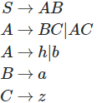
Answer (Contd…)
Let n be the length of a string. We start with the (non-terminal) symbol S which has length (n=1)
Using (n−1) rules of form
(non−terminal)→(non−terminal)(non−terminal)
We can construct a string containing n non-terminal symbols.
Then on each non-terminal symbol of said string of length n we apply a rule of form
(non−terminal)→(terminal) i.e., we apply n rules.
In total we will have applied n−1+n=2n−1 rules.
Example: Observe following grammar in Chomsky-normal form

Slide 15
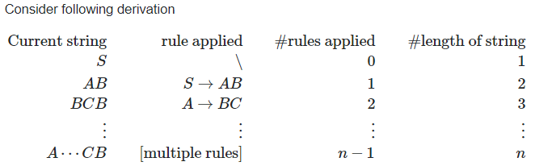
Answer (Contd…)
Example: Observe following grammar in Chomsky-normal form
This last line represents a string containing only non-terminals. You can see that a string containing n non-terminals is derived using (n−1) rules. Let's continue. Applying n rules of form A→a to each non-terminal in the string above gives you a string containing only terminals and thus a string from the language decided by the grammar. The length of the string has not changed (it's still n) but we applied an additional n rules so in total we have applied n−1+n=2n−1 rules.

Slide 16
Question
The format: A->aB refers to which of the following ?
Chomsky Normal Form
Greibach Normal Form
Backus Naur form
None of these

Slide 17
Answer
Pumping lemma for context free language breaks the strings into
a) Two parts
b) Three parts
c) Five parts
d) Six parts

Slide 18
Answer
In pumping lemma for context free language
a) We start by assuming the given language is context free and then we get contradict
b) We first convert the given language into regular language and then apply steps on
c) Both (a) and (b)
d) None of these

